Slide 1
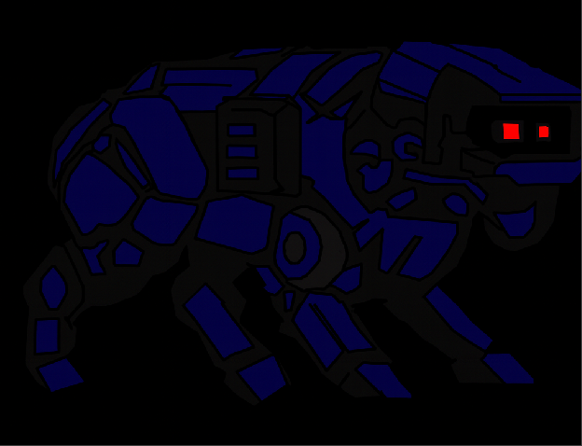


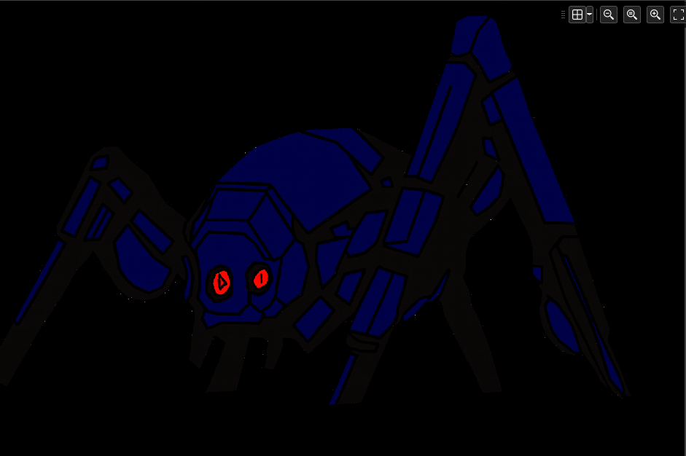
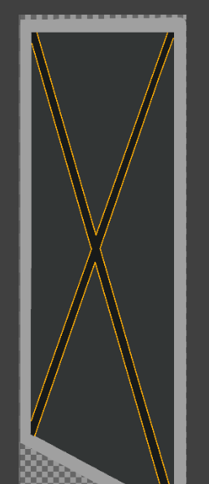
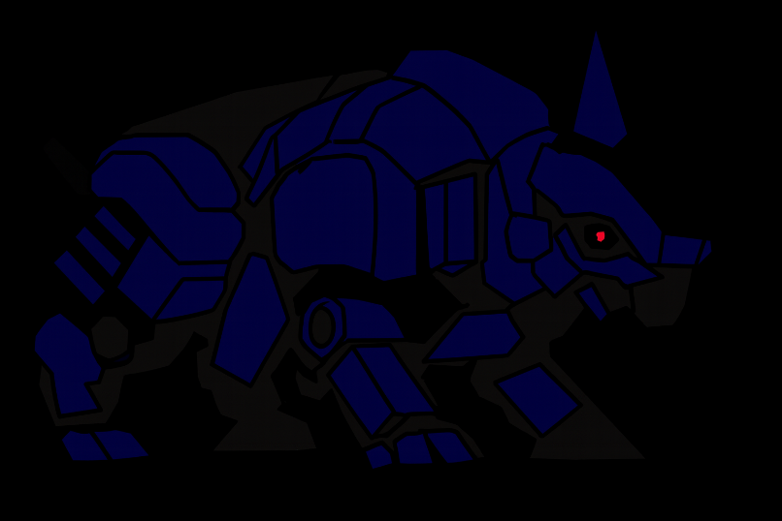
Game Build V.0.1
Date – 21/11/2025
What to do for Next Session
Study more about the specific GML code needed for enemy AI/Camera system
Enemy behaviour is unique between different enemies, as such they will have unique code.
Map Out zone's layout inside the main room.
Design Menu/Start-Up Screens.
Create the rest of the sprites ready for when their designs are ready.
Make the zones sprite canvas 1000x500 and give them a bold colour to start so you can begin mapping out the layout.
Also, attempt to make the main room as large as possible as to have more flexibility when designing the levels/layouts/zones.
Summary Of Session
I have finished outlining the design for the main office room.
I have corrected my enemies AMCD-01 to 04 to remove weird white spots left by the fill tool and now they are ready to be used in the game.
I have created the design/animation stages for the doors.
I have designed the buttons.
Lastly, I have begun adding the designs into Gamemaker and going over them, refining them to look cleaner.
Note: I made the backgrounds black to show them in a much darker environment, I do have PNG images of them with transparent backgrounds as to make them easier to use In Game Maker.

Slide 2
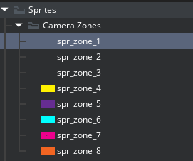
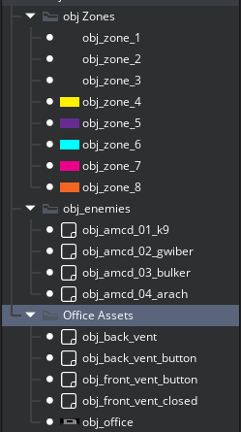
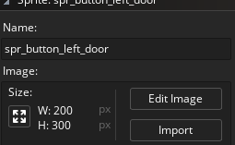
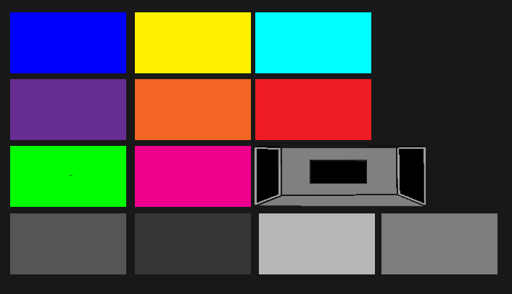
Game Build V.0.1
Date – 24/11/2025
What to do for Next Session
Allocate each zone to a location and name them specific to what contents are in it. For Example, 2 zones will be named obj_left_corridor and obj_left_corridor.
Summary Of Session
Colour coded each zone and named them correctly. These are to be used temporarily before the official designs are completed. The grey coloured zones are for the front views of both the vents and the doors.
I have also Created a template for the Office.
The Office will have a set size of 3000x1050, and the zones will have a set size of 2000x1050.
The Buttons for both the vents and doors are made in Game Maker and will be 200x300px to have more flexibility in designing.
The Camera button will start off being 300x100.

Slide 3
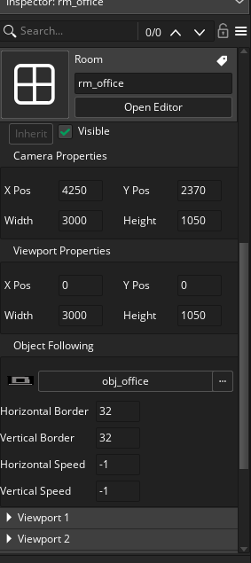
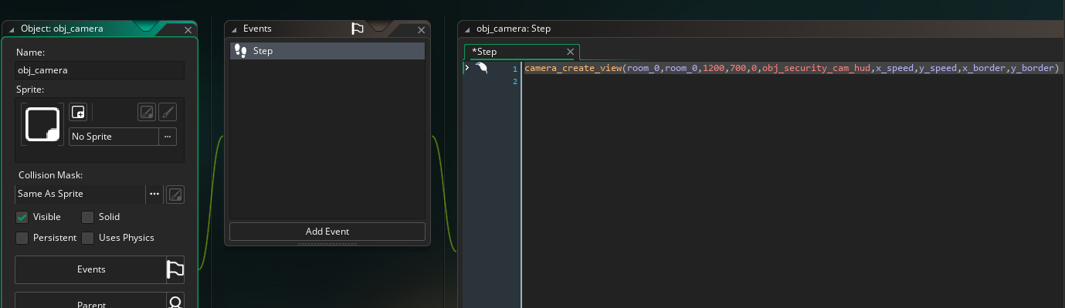
Continuation of previous slide.
Game Build V.0.1
Date – 24/11/2025
What to do for Next Session
Summary Of Session
I used View port feature on game maker to have the main camera be focused on the office.
The code below is the camera, that when I put in camera_apply or shift view onto a button Object it will change OBJ_Camera’s position within the room. It is not done yet but is a massive leap in completing one of my most advanced mechanics.

Slide 4
Test Number | Room | Objects Involved | Expected Outcome | Actual Outcome | Test Outcome
Numerical Value of test beginning with 1. | What Room your test will be conducted in. | The Objects that your test will utilise during the test. | What is expected to happen during the test. | What Actually happened. | Did you have to do anything In reaction to the test? Fixing errors or changing code.
1 | game_manor_stage_1 | Player_OBJ | Player moves correctly with WASD keys. | The player did execute the correct functions applied to it from pressing one of the WASD keys. | Code wasn't chnaged.

